Slide 1

POWER BI PROJECT
OPD Patient & Admissions Analysis Dashboard
Summer Training — Power BI | Chandigarh Group of Colleges, Jhanjeri
Presented by
Course
Guided by
Date
Arnav Kaushal | 2420675
B.Tech — AI&DS
Mrs. Ashima And Mrs. Mandeep
03 July 2026

Slide 2
Agenda
01
Problem Statement & Objective
06
Dashboard Walkthrough
02
Dataset Overview
07
Key Insights & Findings
03
Data Model — Star Schema
08
Publishing to Power BI Service
04
Power Query — Cleaning Steps
09
Challenges & Learnings
05
DAX Measures
10
Conclusion & Q&A
2 / 14

Slide 3
01 Problem Statement
What problem does this dashboard solve?
3 / 14

Slide 4
Problem Statement & Objectives
The Problem
Target User
Hospital staff tracked OPD admissions, bed occupancy, and billing manually, with no single view tying patient volume, length of stay, and revenue together — so trends by condition and month took days to spot.
OPD Manager and Hospital Administration team who needed a live view of patient inflow, condition mix, and billing performance without compiling weekly Excel reports.
Project Objectives
Connect & clean the raw dataset using Power Query
Design an interactive multi-page dashboard with 5+ visual types
Build a star schema data model with correct relationships
Publish the final report to Power BI Service
Create at least 5 meaningful DAX measures
4 / 14

Slide 5
02 Dataset Overview
Source, structure, and key fields
5 / 14

Slide 6
Dataset Overview
Kaggle
CSV
15
Source
File Type
Columns
Key Columns Used
Data Quality Steps (Power Query)
Column | Role in Dashboard
Name | Patient identifier for record-level detail
Date of Admission | Date dimension — monthly trend analysis
Medical Condition | Diagnosis grouping for slicers and bar chart
Billing Amount | Revenue — base for SUM and KPI measures
Room Number | Bed/room occupancy tracking
Admission Type | Elective / Urgent / Emergency slicer
Removed duplicate rows
Changed data types (Date, Number)
Renamed columns for clarity
Filtered out incomplete admission records –None
Created LOS_Days and Admission Month calculated columns
6 / 14

Slide 7
03 Data Model
Star schema design & relationships
7 / 14

Slide 8
04 Dashboard Walkthrough
Pages, visuals, and interactivity
11 / 15

Slide 9
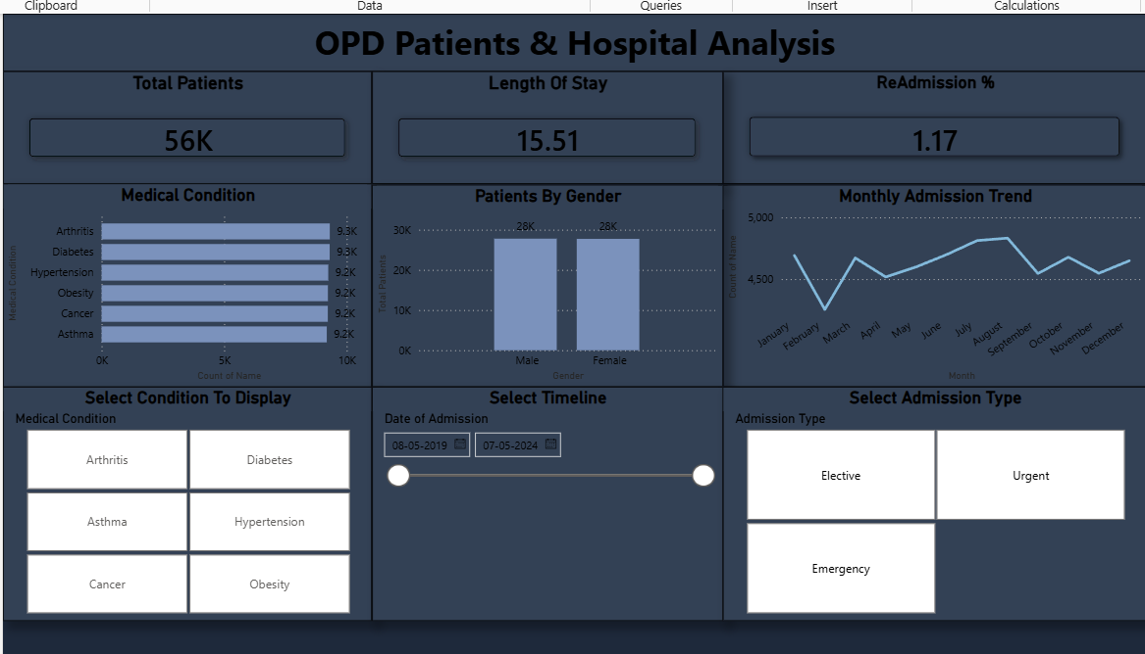
Dashboard — Page 1: Overview
Visuals on this page
KPI Cards — Total Patients, Avg LOS, Readmission %
Bar Chart — Patients by Medical Condition
Line Chart — Monthly Admission Trend
Column Chart — Patients by Gender
Slicers — Condition / Timeline / Admission Type
Key Insight
At a glance: 56K patients were admitted with an average stay of 15.5 days and a 1.17% readmission rate, with admission load spread evenly across all six tracked conditions and both genders.
12 / 15

Slide 10
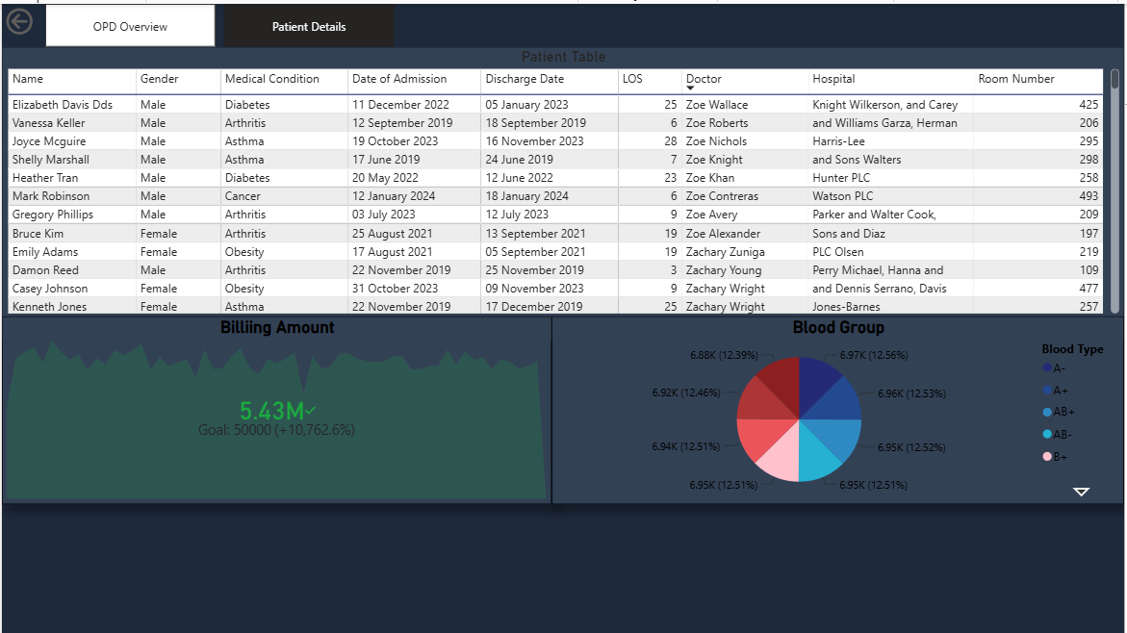
Dashboard — Page 2: Patient Details
Visuals on this page
Patient Table — Name, Condition, Doctor, Hospital, LOS
KPI — Billing Amount vs Target
Pie Chart — Blood Group Distribution
Page Navigator — switch between report pages
Drill-through from Overview page visuals
Key Insight
Total billing reached 5.43M against a 50,000 per-patient target, while all eight blood groups stay tightly clustered around 12.5% each, showing a well-balanced patient base.
13 / 15

Slide 11
Key Findings & Insights
Patient load is evenly spread across all six tracked conditions (9.2K-9.3K each), so no single diagnosis dominates OPD capacity planning.
Average length of stay is 15.51 days against a low 1.17% readmission rate, showing very few patients return within 20 days of discharge.
01
04
Monthly admissions hold a steady 4,500-5,000 patient band with a visible peak in August, useful for staffing and bed-allocation forecasts.
Total billing of 5.43M of Recent Month far exceeds the per-patient target, and all eight blood groups stay within a tight 12.4%-12.6% band, showing balanced billing performance and a representative donor/patient mix.
02
05
Gender split is nearly identical (28K male vs 28K female), confirming the patient base is balanced across demographics.
03
14 / 15

Slide 12
Conclusion & Thank You
Successfully built an end-to-end Power BI solution from raw data to published dashboard
A low 1.17% readmission rate reflects strong discharge quality, while the 15.51-day average stay stands out as the clearest opportunity area for the hospital to act on.
Proud of the Avg LOS and Readmission % DAX measures, built using DATEDIFF and DIVIDE over the cleaned admission/discharge dates.
Future scope: Add a predictive readmission-risk model and a cost-per-condition page using the Billing Amount and Insurance Provider fields.
Questions & Feedback Welcome
15 / 15

